Slide 1

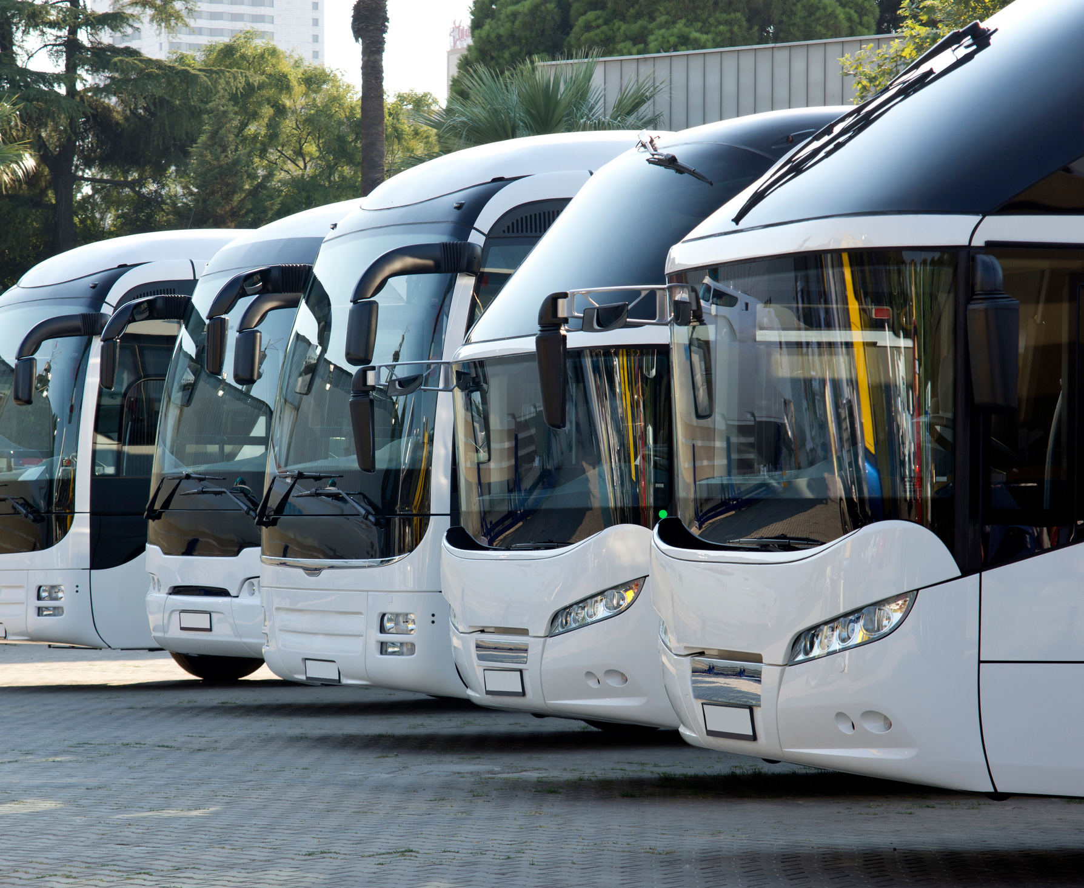

Today's Topic
Public Transport
Presentations are communication tools.

Slide 2

Today's Teacher
Mr. Chad Gibbons
Presentations are communication tools that can be used as lectures, speeches, reports, demonstrations, and more.

Slide 3

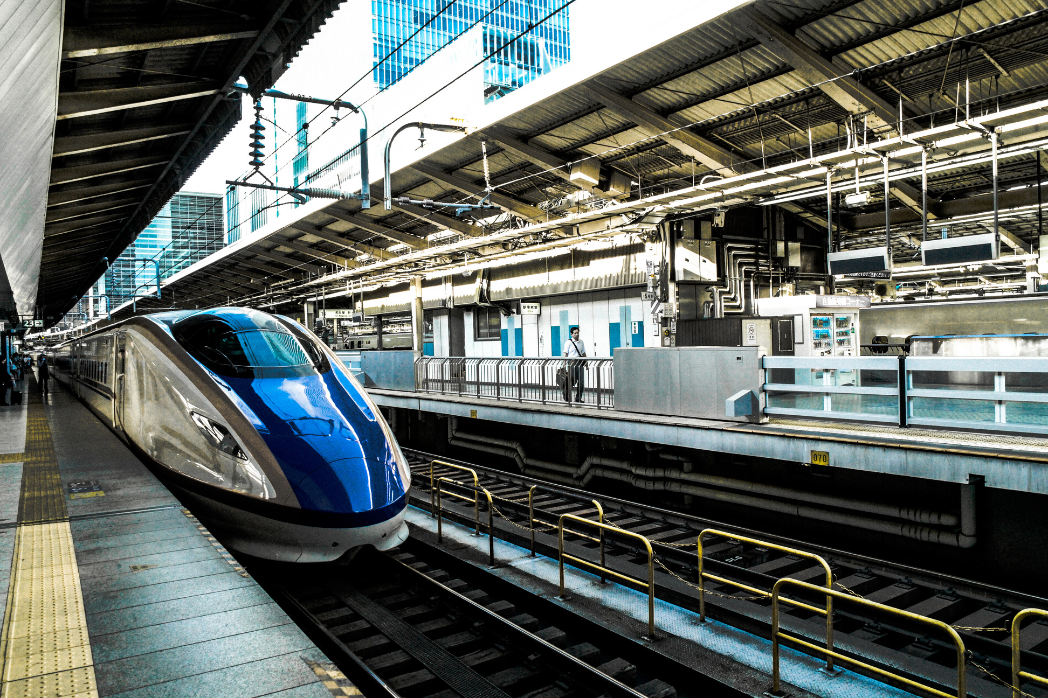
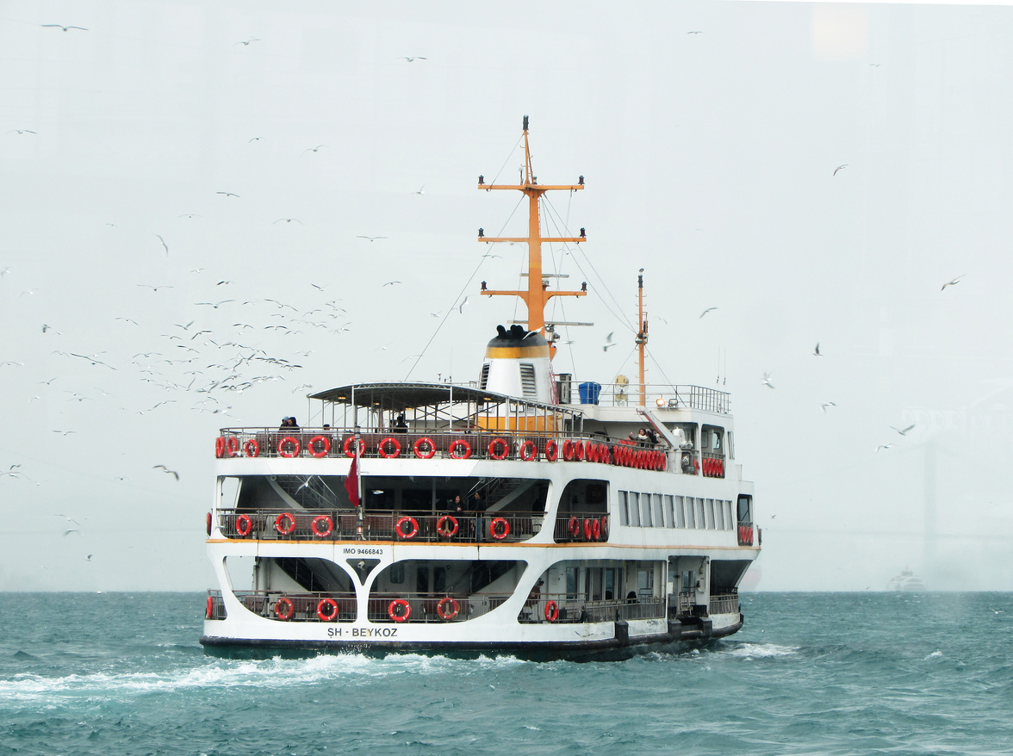
Learn About
Definition
Transportation
Station & Ports
Quiz
Answer
Conclusion

Slide 4

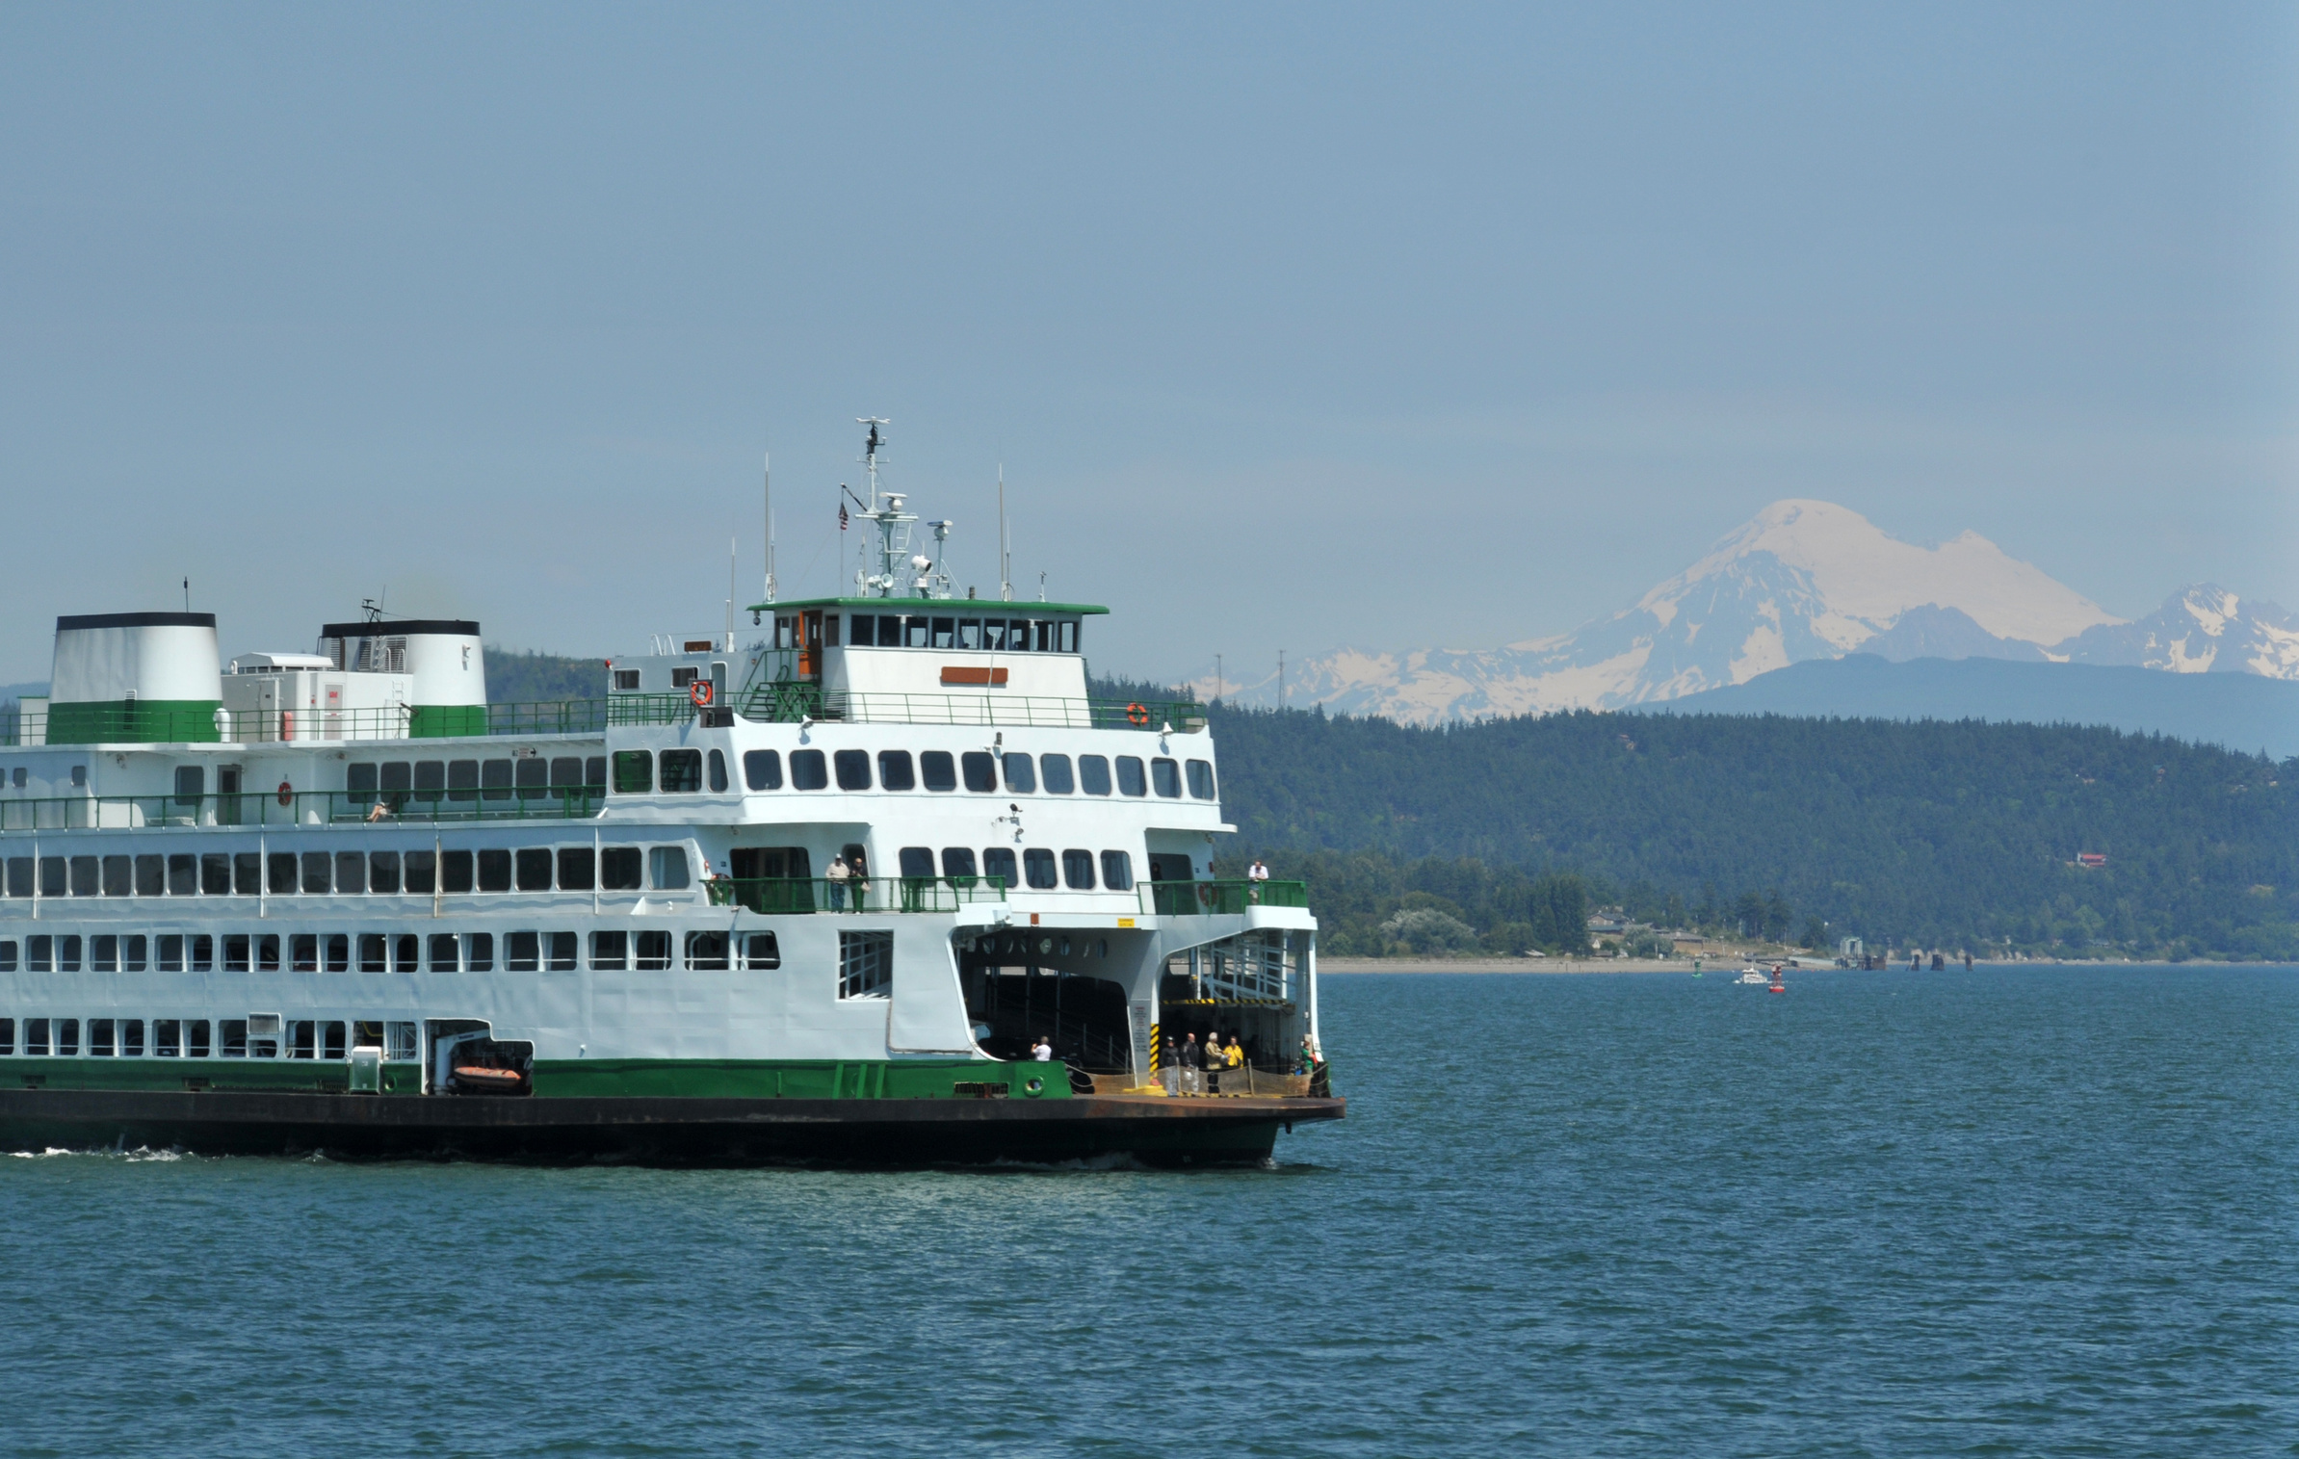
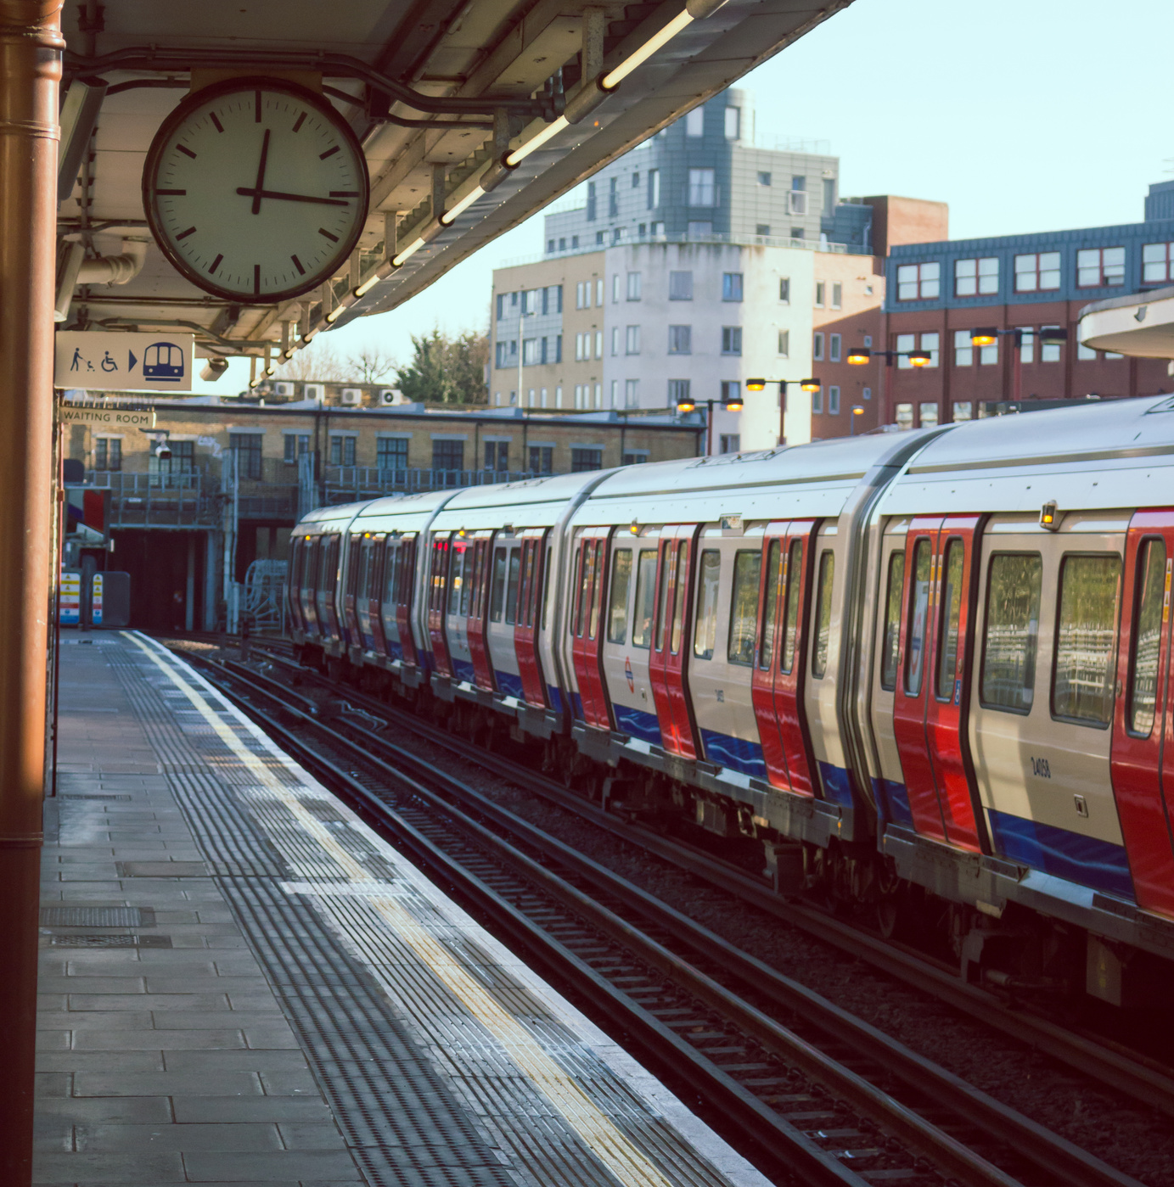

Definition
Public Transport
Presentations are communication tools that can be used as lectures, speeches, reports, demonstrations, and more.

Slide 5
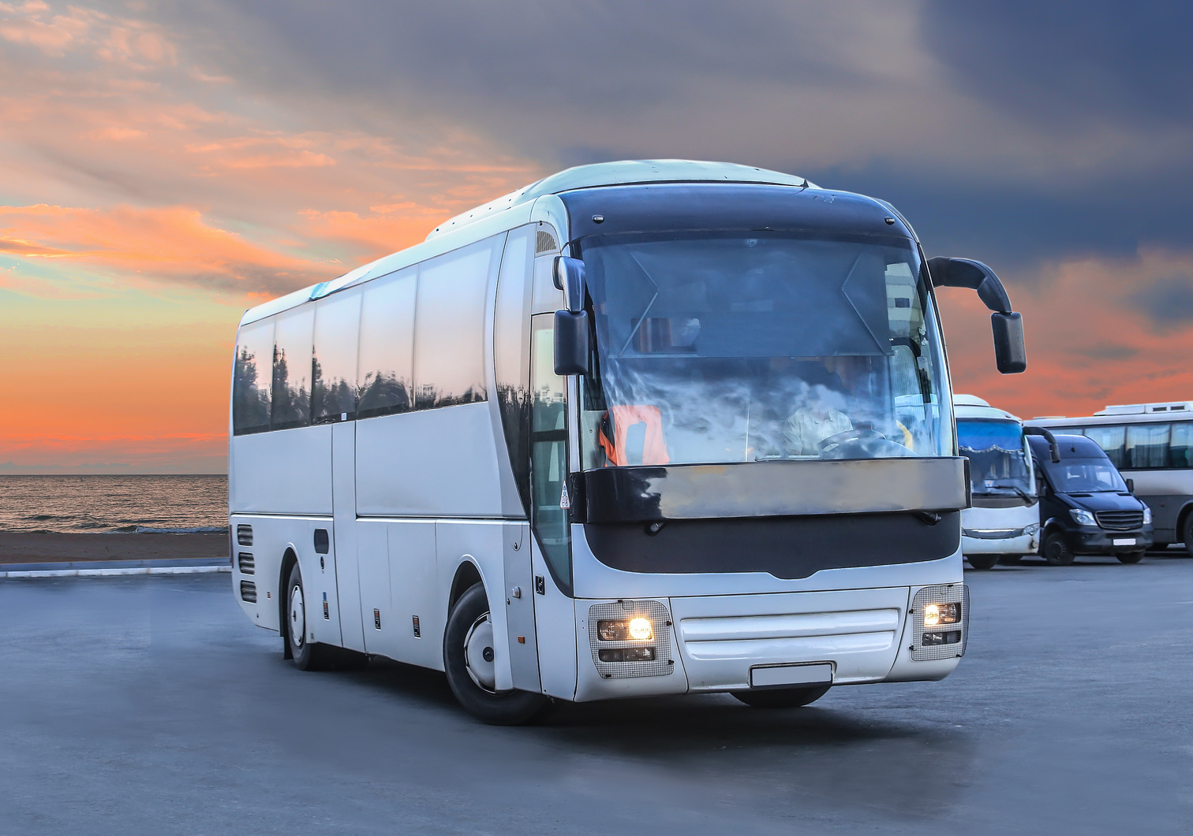
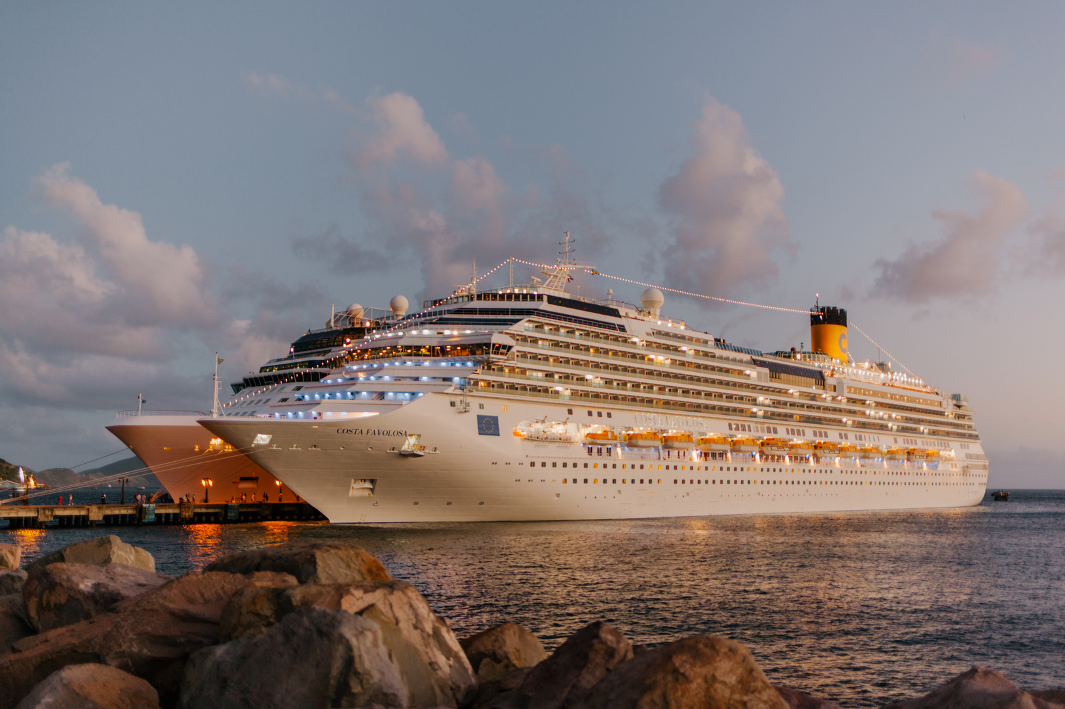




Transportation
Presentations are communication tools that can be used as lectures, speeches, reports, demonstrations, and more.
Land
Water
Air

Slide 6

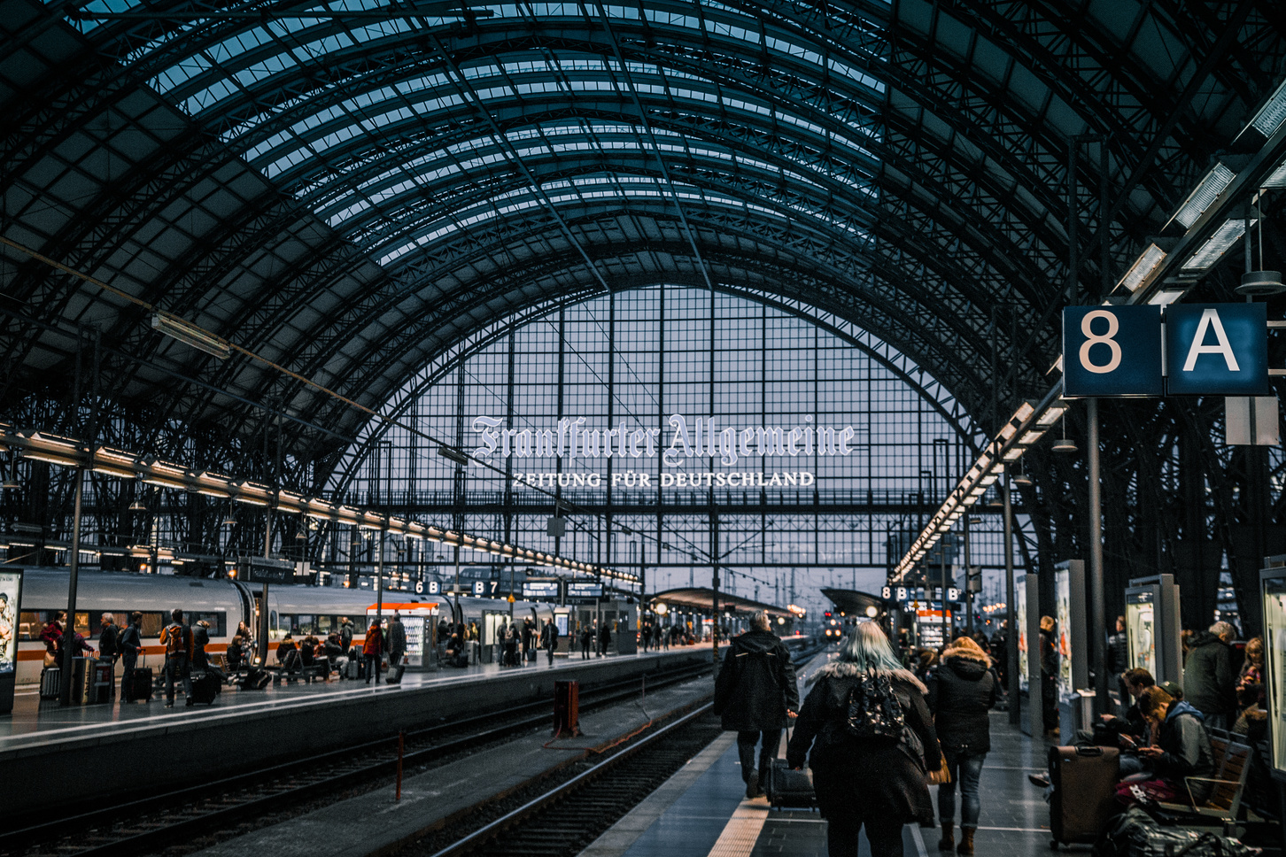


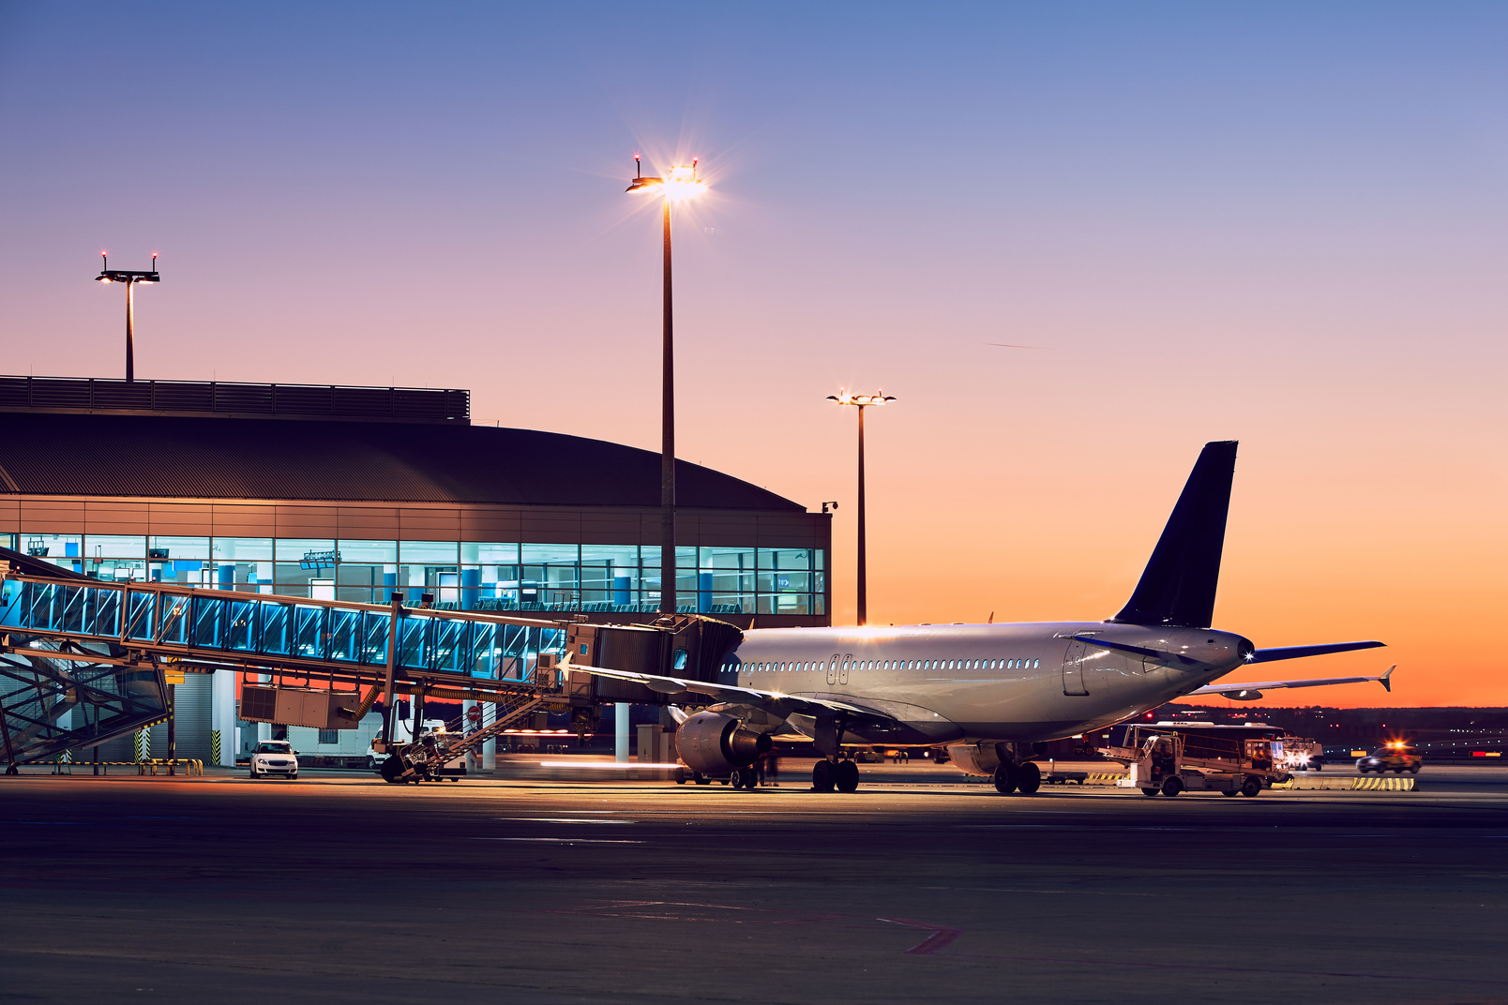
Presentations are communication tools that can be used as lectures, speeches, reports, demonstrations, and more.
Station
Port
Station & Ports
Airport

Slide 7
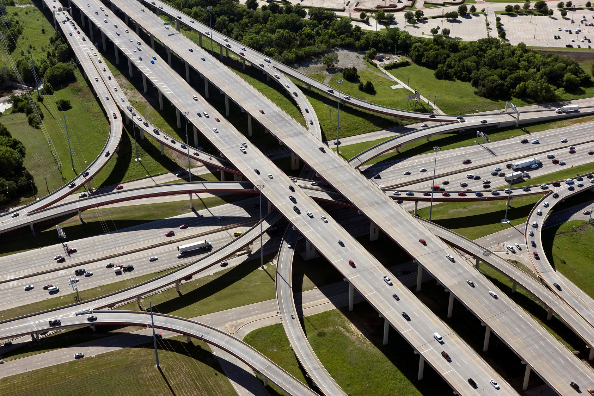

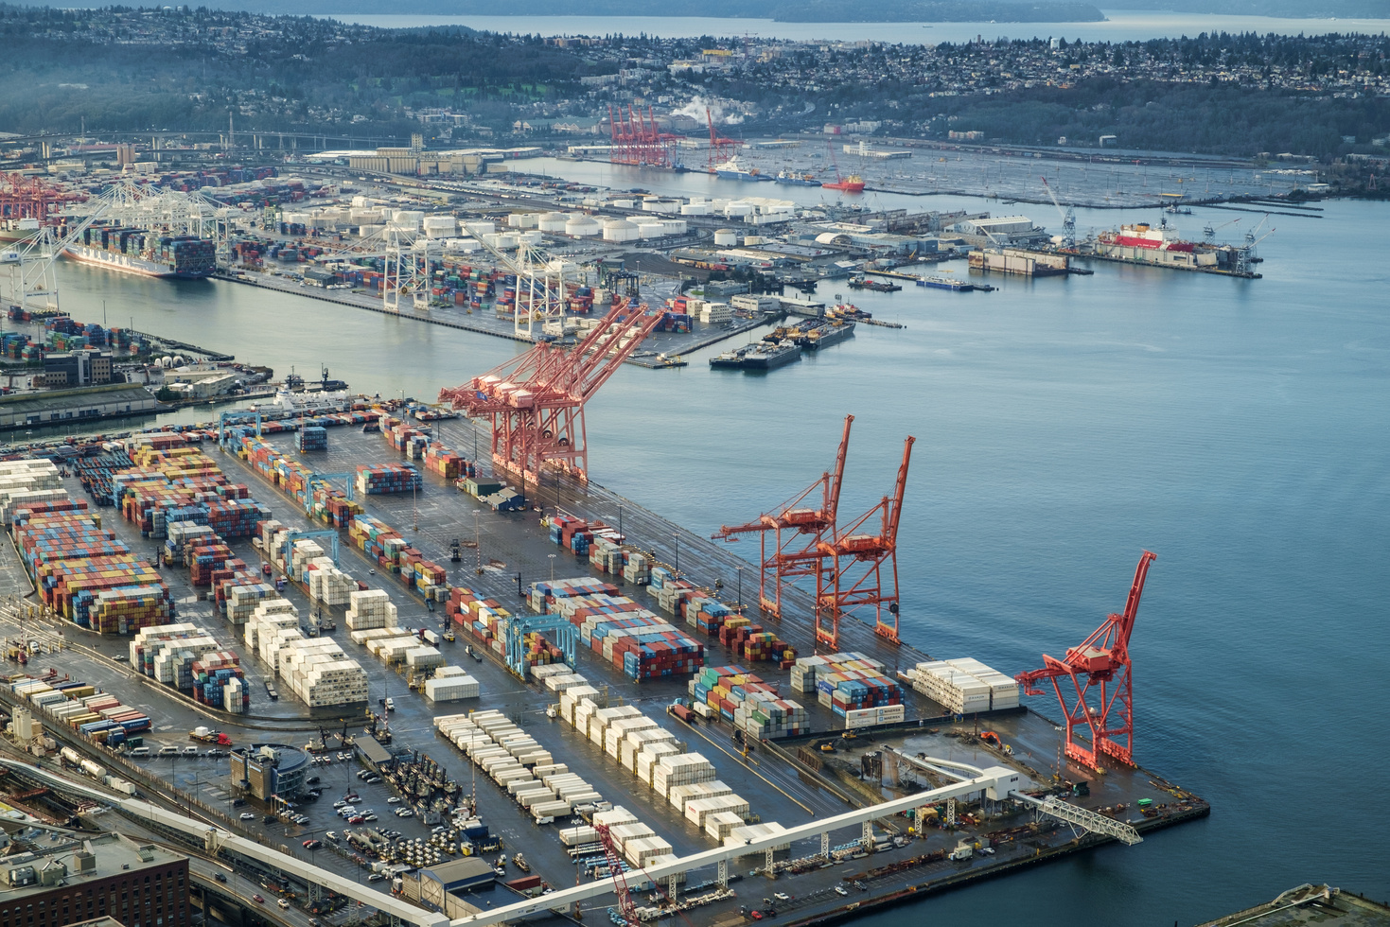

A.
B.
Quiz!
Station
Toll Road
C.
D.
which place does plane land?
Port
Airport

Slide 8

Answer: D
Presentations are communication tools that can be used as lectures, speeches, reports, demonstrations, and more.
Airport

Slide 9
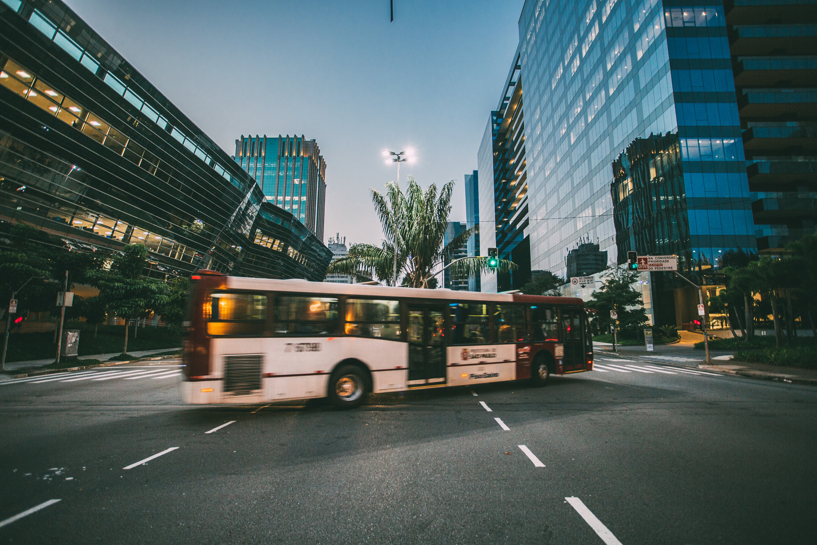
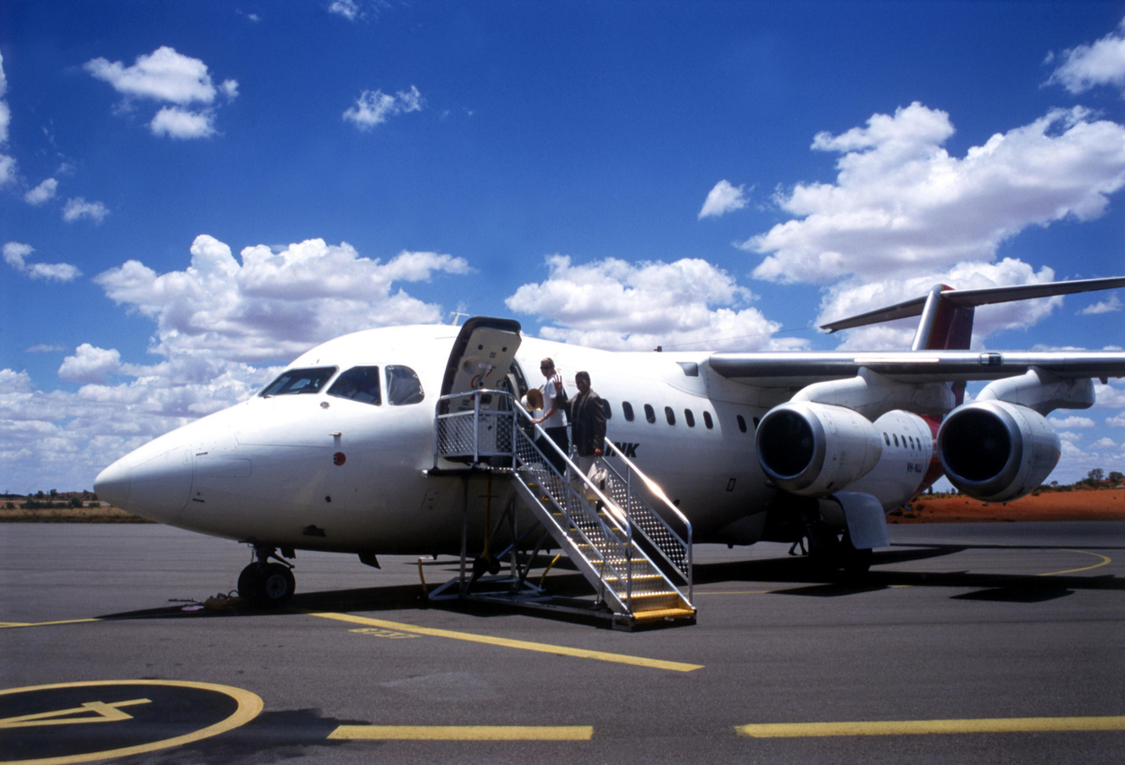
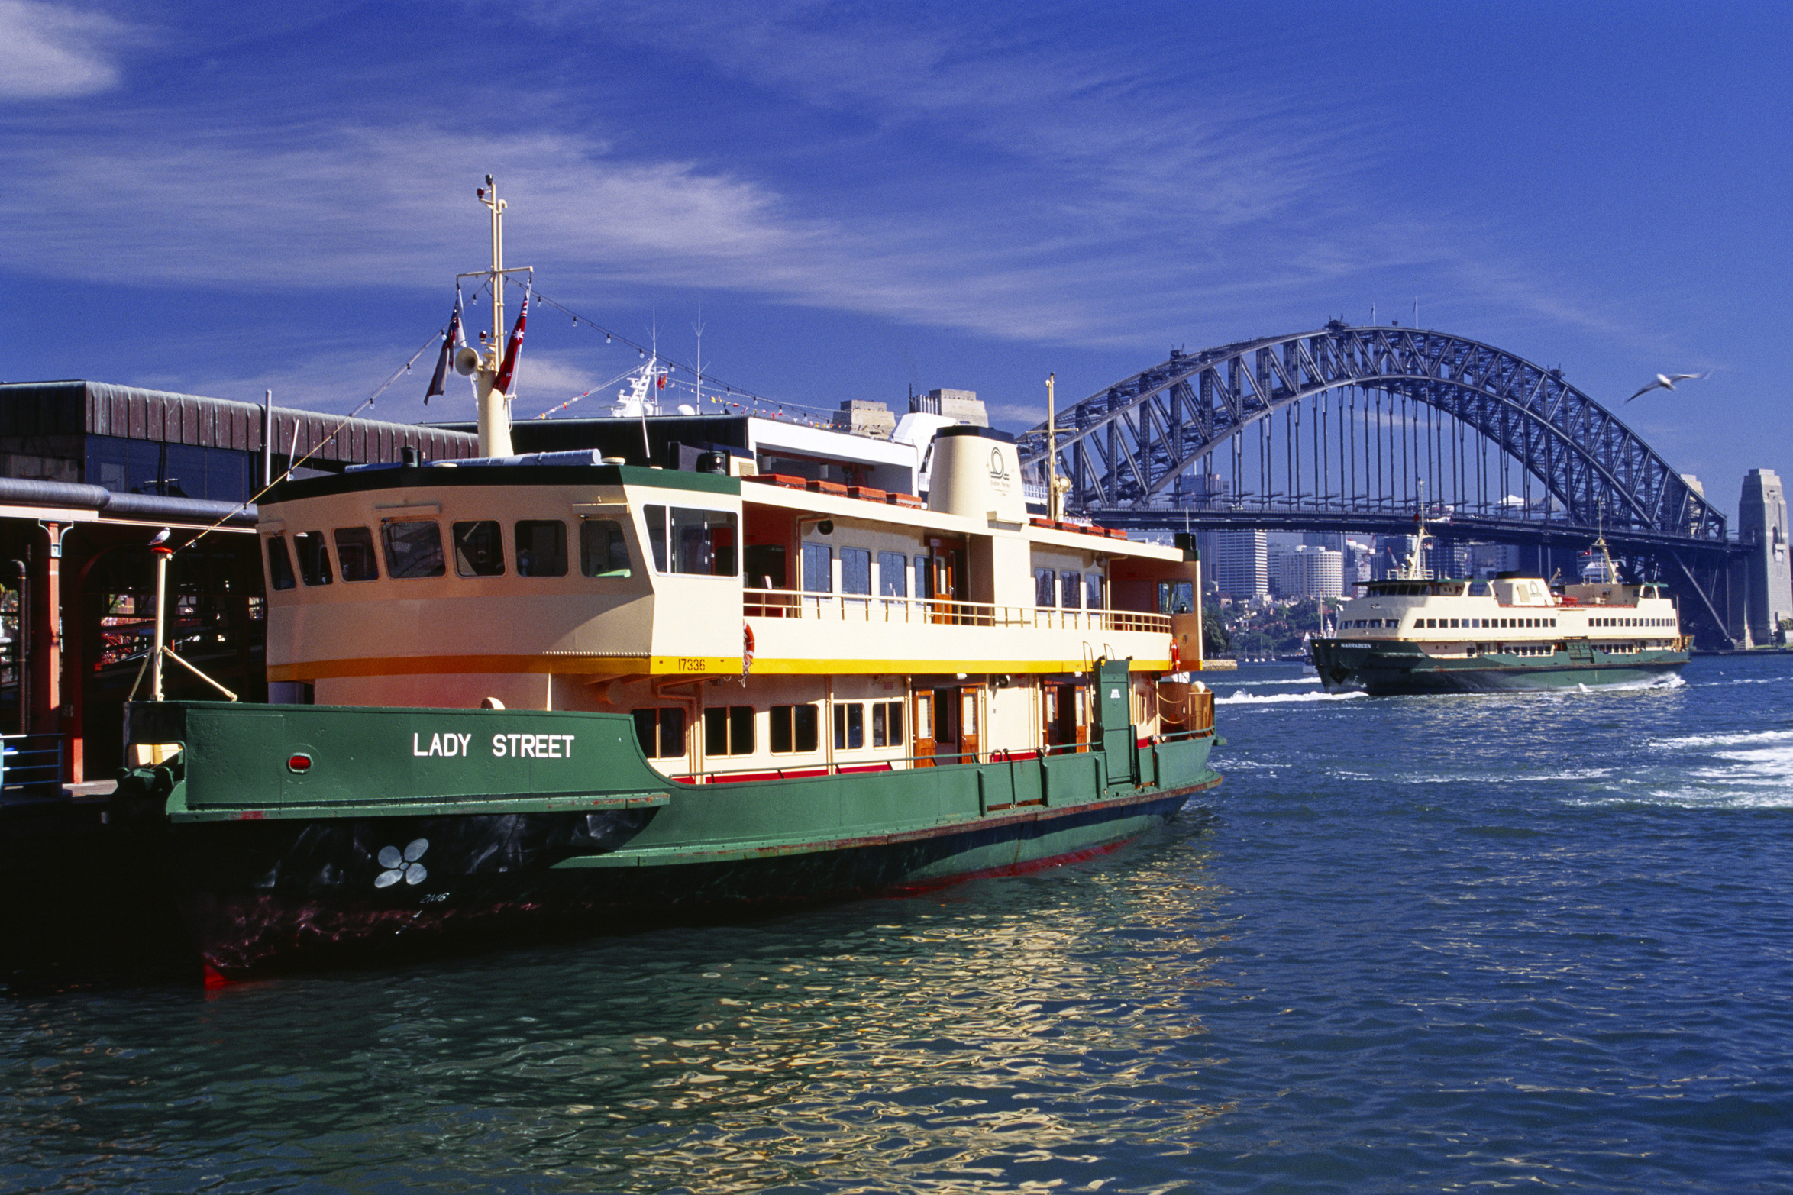
Conclusion
Presentations are communication tools that can be used as lectures, speeches, reports, demonstrations, and more.

Slide 10
Thank You!
Presentations are communication tools.
Created by
Mr. Chad Gibbons

